Slide 1
Successful Dimensional Modeling of Very Large Data Warehouses
By Bert Scalzo, Ph.D.
Bert.Scalzo@Quest.com

Slide 2
Learning Objectives
Application Nature versus Data Modeling Approach
Important DW/DM Concepts for “Star Schema” Design
Transforming a simple data model into a “Star Schema”
Why Hierarchies are better than Snowflakes
Common Aggregation/Summarization Themes
Recommendations for Implementing Facts
Recommendations for Indexes and Keys
Oracle Issues (not modeling topic, but always asked for)
  Partitioning Options
  Indexing Options
  Tuning Star Queries
  Materialized Views

Slide 3
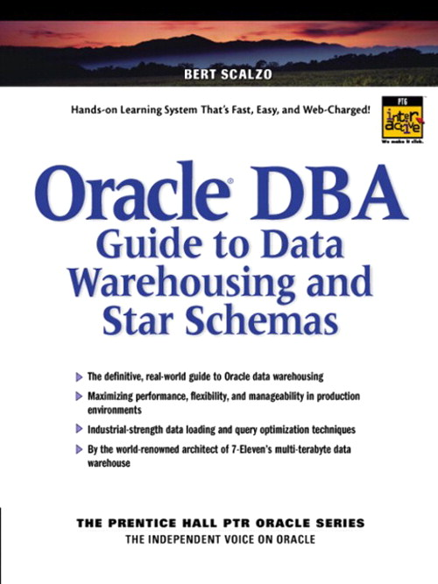


New 2nd Edition – June 2005

Slide 4
About Quest Software
Quest Software (NASDAQ: QSFT)
Founded: 1987
More than 2000 employees in 40 offices: North America, South America, Europe, Asia, Australia
Application management leader: 75% of Fortune 500
Develop, deploy, manage and maintain enterprise applications without downtime or business interruption
Best known in the Oracle community for TOAD, Spotlight, Quest Central, Shareplex, etc.

Slide 5
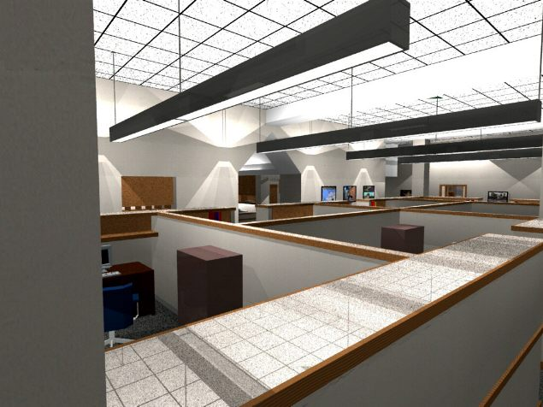
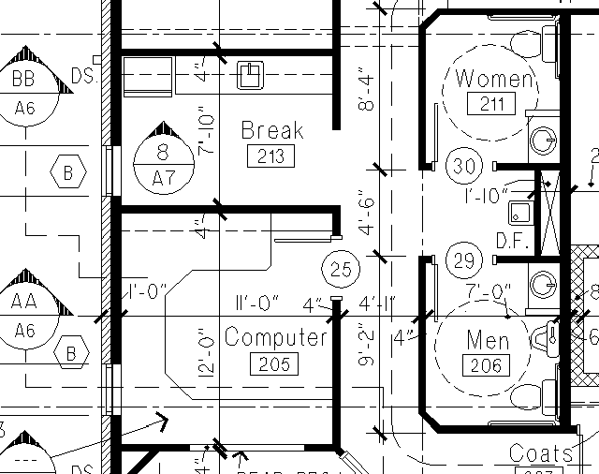
Why do we model?
Would you build an office without a blueprint?
The Architect will create the first high level drawings to validate the concept with the client and then make a more detailed plan (i.e. the blueprint ) for the Contractor …
The Contractor will take this
blueprint and optimise it based
on technical constraints. The Contractor will then create the actual office.

Slide 6
Where in Development Lifecycle
Analysis
Some shops just treat this as one big “Design” task
Design
Conceptual
Reengineer
Physical
Monitor
&
Maintain
Develop
Deploy
Not uncommon for Star Schema data model to concentrate more on physical design characteristics

Slide 7
World of Modeling …
Business Process Modeling
(BPM)
Improve process efficiency
Define/document Bus. Processes
- create correct and complete
application requirements
End-user
IT Partner/Liaison
Business Analyst
Object-Oriented Modeling
(OOM - UML)
Support for all UML diagrams
- Analyze requirements
- Design application
Reverse/forward engineer code
System Architect
System Analyst
App Developer
Conceptual Data Modeling
(CDM – E/R)
Identify all data & relationships
- E/R (Entity/Rel’ship) diagrams
- DB independent view
Business Rules?
Bus. Analyst
Data Architect
Data Analyst
DBA
DB Developer
DB Architect
Physical Data Modeling
(PDM)
DB-specific model
Reverse engineer existing DB
Create/Update DB from model
Data Warehouse Modeling
Quest’s “QDesigner” synchronizes models from all levels in a single tool

Slide 8
Know Your Application …
What type of application are you building:
On Line Transaction Processing (OLTP)
Operational Data Store (ODS)
On Line Analytical Processing (OLAP)
Data Mart / Data Warehouse (DM/DW)

Slide 9
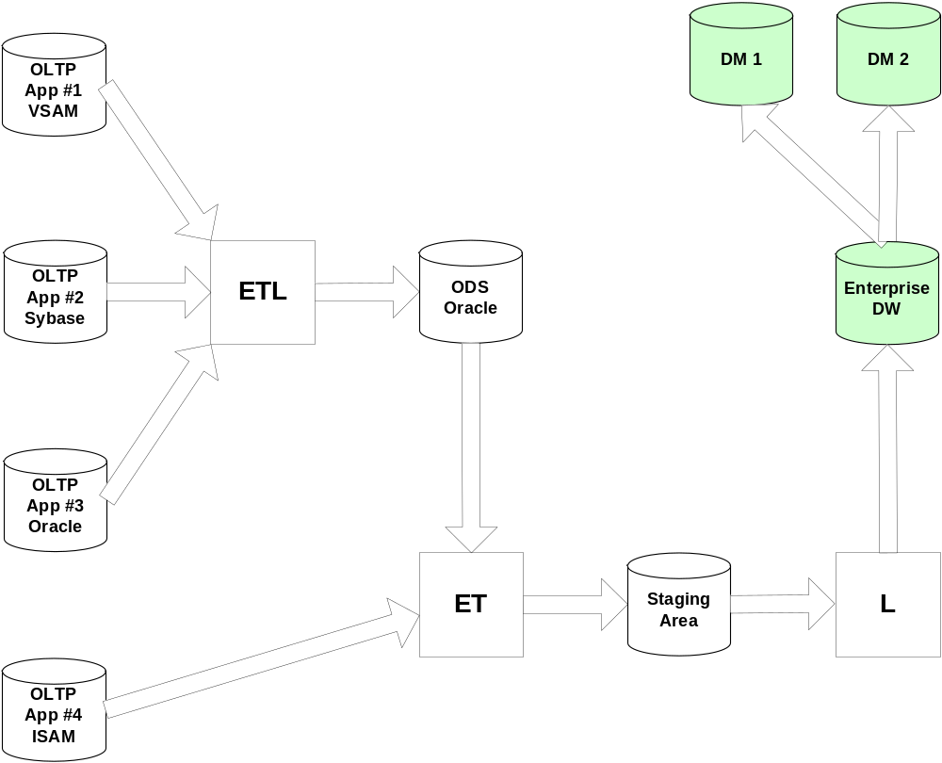
Warehouse Architecture

Slide 10
Application Natures…
 | OLTP | ODS | OLAP | DM/DW
Business Focus | Operational | Operational Tactical | Tactical | Tactical Strategic
End User Tools | Client Server Web | Client Server Web | Client Server | Client Server Web
DB Technology | Relational | Relational | Cubic | Relational
Trans Count | Large | Medium | Small | Small
Trans Size | Small | Medium | Medium | Large
Trans Time | Short | Medium | Long | Long
Size in Gigs | 10 – 200 | 50 – 400 | 50 – 400 | 400 - 4000
Normalization | 3NF | 3NF | N/A | 0NF
Data Modeling | Traditional ER | Traditional ER | N/A | Dimensional

Slide 11



Embrace New Concepts
“Teach Old Dog New Tricks”
Throw out any OLTP baggage
Forget OLTP “Golden Rules”
X

Slide 12
Star Schema Design
“Star schema” approach to dimensional data modeling was pioneered by Ralph Kimball
Dimensions: smaller, de-normalized tables containing business descriptive columns that end-users query on
Facts: very large tables with primary keys formed from the concatenation of related dimension table foreign key columns, and possessing numerically additive, non-key columns used for calculations during end-user queries

Slide 13
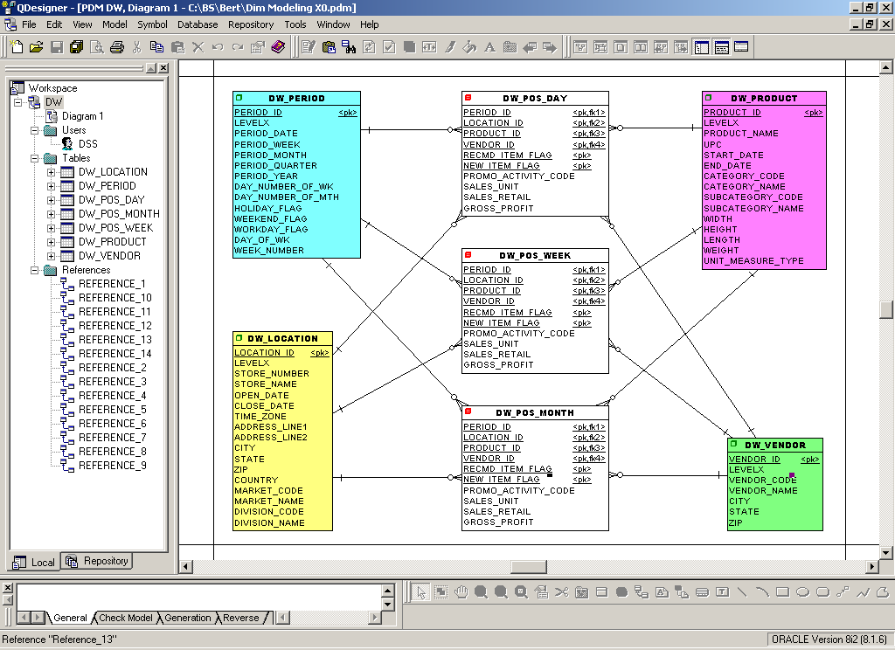
Facts
Dimensions

Slide 14
10^{8th} -10^{10th}
10^{3rd} -10^{5th}

Slide 15
Transform OLTP Model
Fold OLTP model into itself to form a Star:
De-Normalize parent/child relationships
De-Normalize lookup relationships
Use surrogate or meaningless keys
Create and populate a time dimension
Create hierarchies of data in dimensions

Slide 16
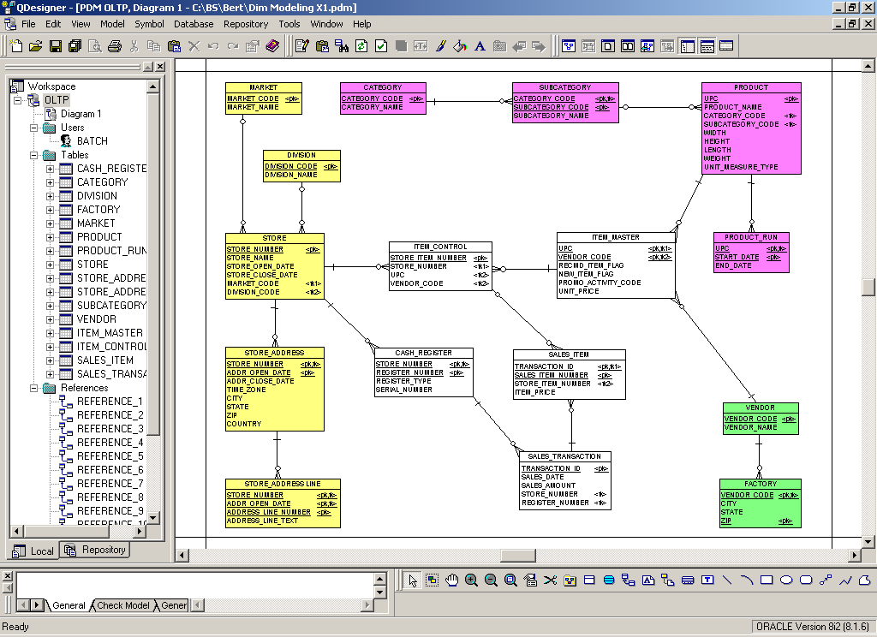
OLTP Model

Slide 17
Dimensional Model

Slide 18
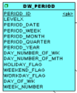
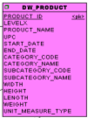
Dimension Hierarchies
SQL> select distinct levelx from dw_period;
LEVELX
--------------------
DAY
MONTH
QUARTER
WEEK
YEAR
SQL> select distinct levelx from dw_product;
LEVELX
--------------------
ALL PRODUCTS
CATEGORY
ITEM
PSA
SUB_CATEGORY

Slide 19
Avoid Snowflakes
Avoid natural desire to normalize model:
Complicates end-user query construction
Adds additional level of “JOIN” complexity
Database optimizers do not handle very well
Saves some space at the cost of longer queries

Slide 20
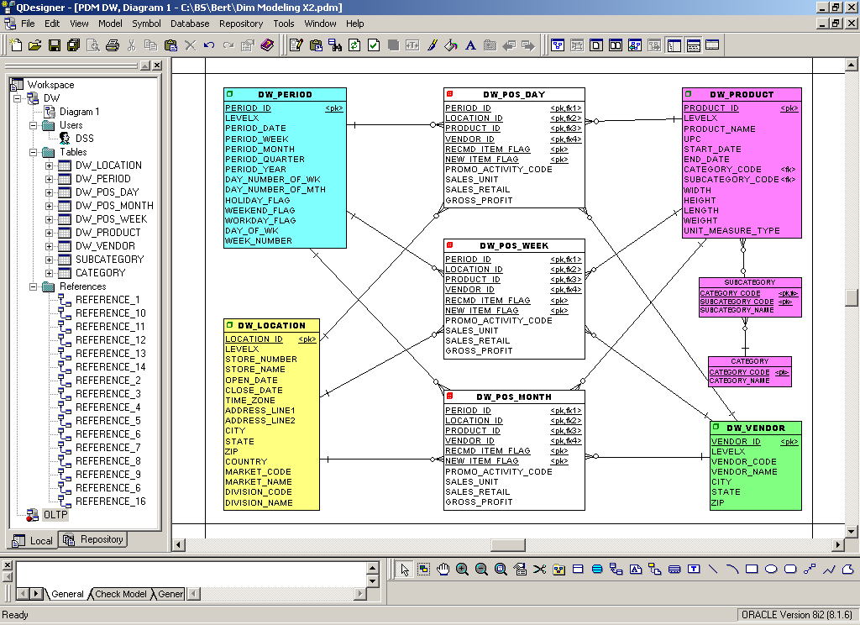
Snowflake Model

Slide 21
Common Aggregations
Build end-user driven aggregate tables:
By time (e.g. week, month, quarter, year)
By geographic regions (e.g. time zones)
By end-user reporting interests (e.g. beer)
By dimension hierarchy (e.g. product category)
Aggregates should be 5 to 10 times smaller

Slide 22
Time Aggregates

Slide 23
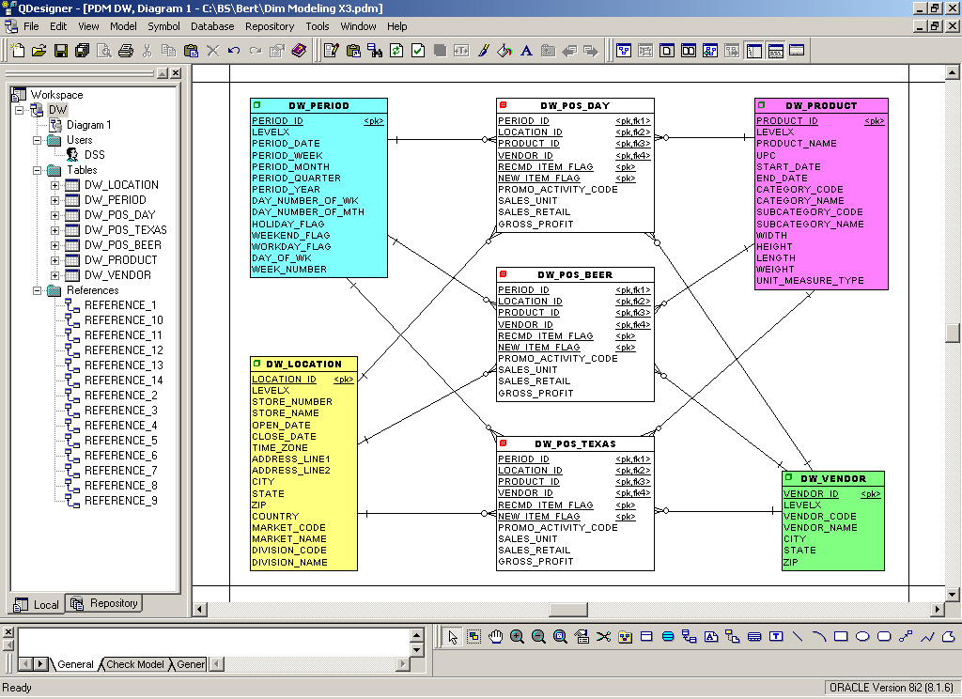
Non-Time Aggregates

Slide 24
Index Design
One Very Simple Rule:
All fact table, foreign key columns must have individual bitmap indexes on them
All dimension table columns should each have individual bitmap indexes

Slide 25
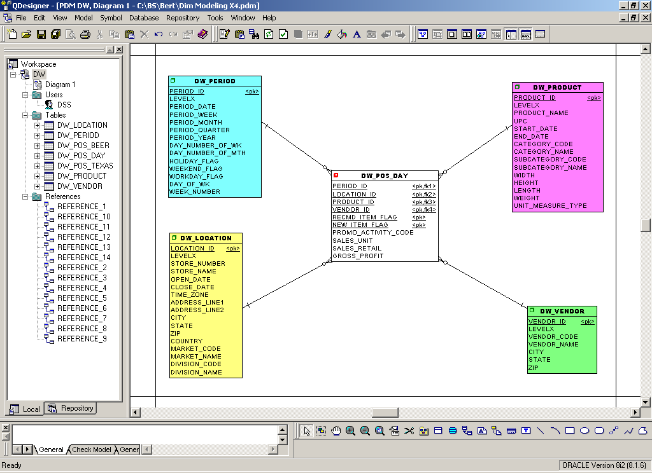
Nighttime - 10 B-Tree Indexes

Slide 26
Daytime - 48 Bitmap Indexes!!!

Slide 27
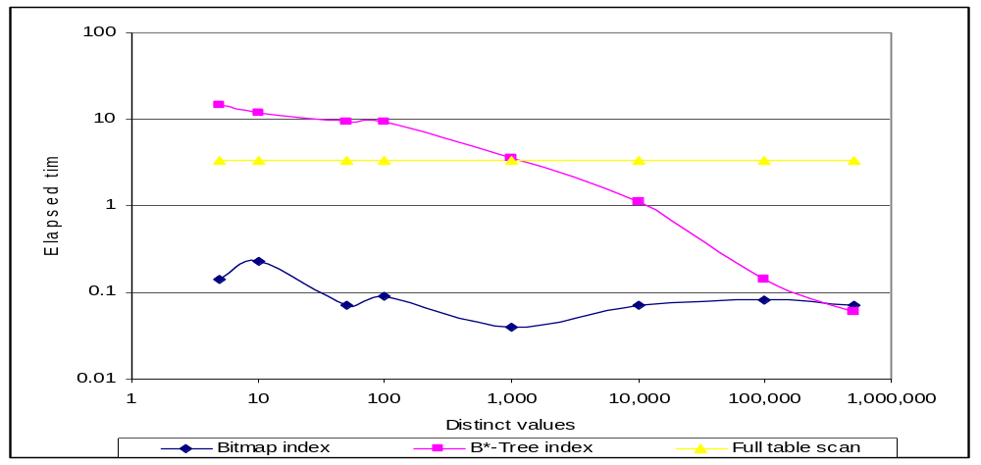
Bit-map indexes
  Contrary to widespread belief, can be effective when there are many distinct column values
  Not suitable for OLTP however

Slide 28
Key Fact Table Issues
Fact tables should:
NOT create or enable foreign key constraints (exception – MV’s need FK’s for query rewrites)
NOT create or enable table check constraints
NOT create or enable primary/unique constraints
(use unique indexes which offer parallel creation)
NOT create or enable column check constraints
(other than simple NOT NULL check constraints)
NOT create or enable “row” level triggers
NOT enable logging on tables or their indexes

Slide 29
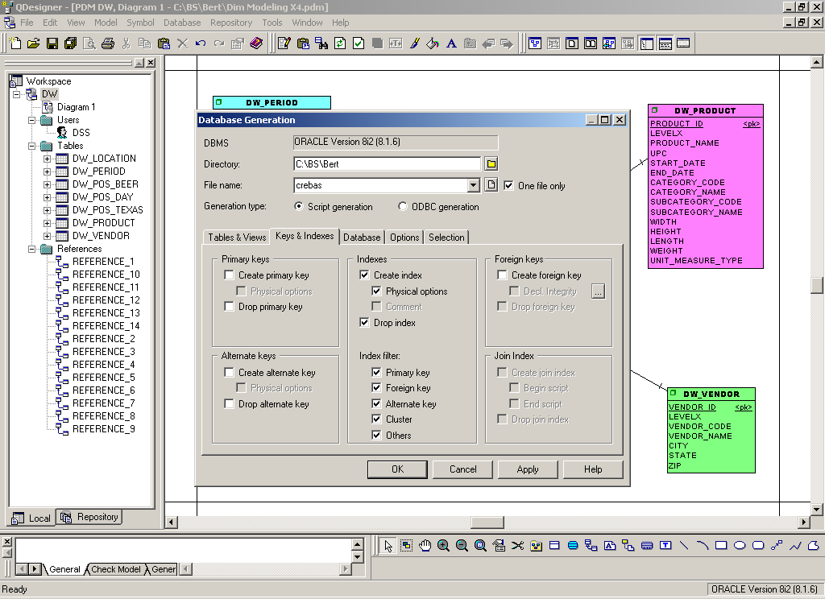
No PK/UK/FK Constraints

Slide 30
Key Oracle Issues …
Trust me – no way to build a large DW/DM in Oracle 7.X (don’t recommend 8.X either)
Very brief overview in next few slides of:
  Partitioning options
  Indexing options
  Comparative timings
  Tuning ad-hoc Star queries
  Serial versus Parallel queries
  Materialized Views …

Slide 31
Oracle Partitioning
Way beyond the scope of dimensional modeling, but:
Use Range or List Partitioning using time dimension
Fact unique index = local, prefixed b-tree index
Fact time index = local, prefixed bitmap index
Fact non-time index = local, non-prefixed bitmap index
If any non-time dimension provides a good locality of reference for typical user queries, then sub-partition on that dimension (i.e composite partitioning) – but note that under non-ideal data distributions, things could be worse or sometime even much worse…

Slide 32
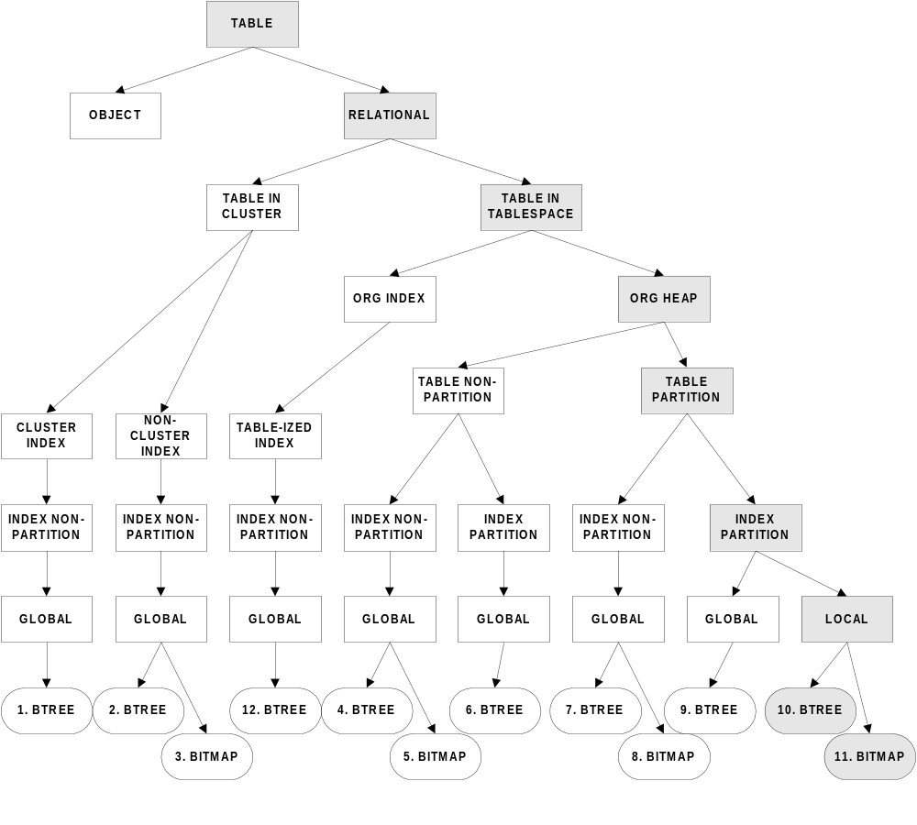
Indexing Options …

Slide 33
Query Time vs. Table Design
Fact Implementation | Timing
Regular “Heap” Table | 9,293
Single Column Partition | 4,747
Multi Column Partition | 4,987
Composite Partition | 6,319
Index Organized Table | 12,508
Partition Index Organized | 14,902
NOTE: specific to my data and user queries

Slide 34
Tuning Star Queries …
Way beyond the scope of dimensional modeling, but:
Use Range Partitioning based upon your time dimension (do not try to force use of hash or composite partitioning)
Fact unique index uses local, prefixed b-tree index
Fact time index uses local, prefixed bitmap index
Fact non-time index use local, non-prefixed bitmap index

Slide 35
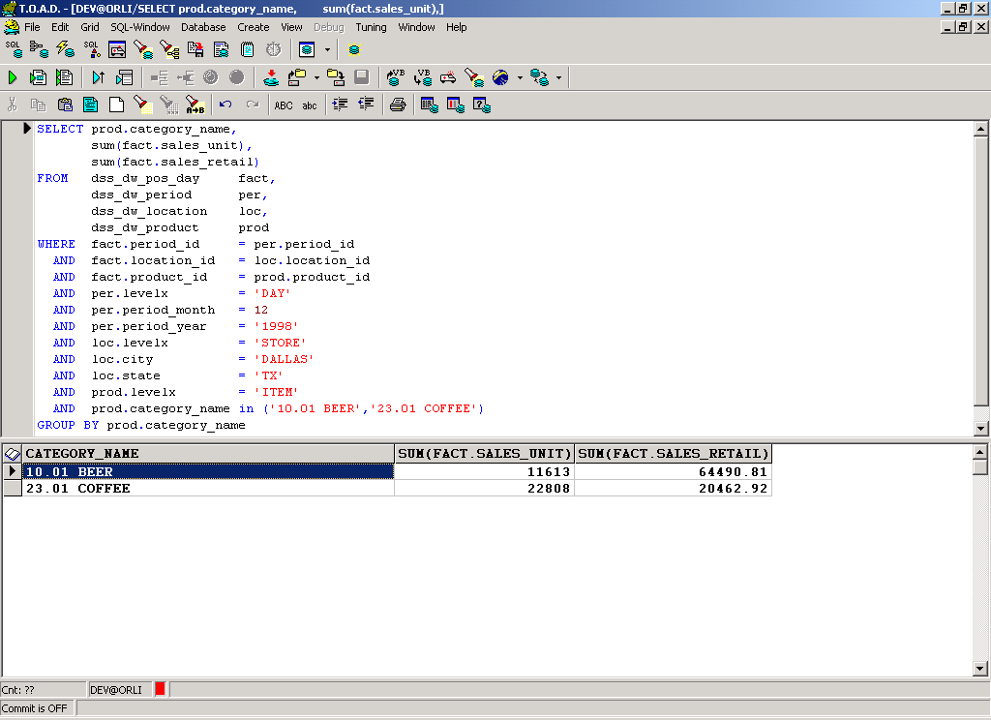
Example BI Generated Query
Query: beer and coffee sales for November of 98 in Dallas

Slide 36
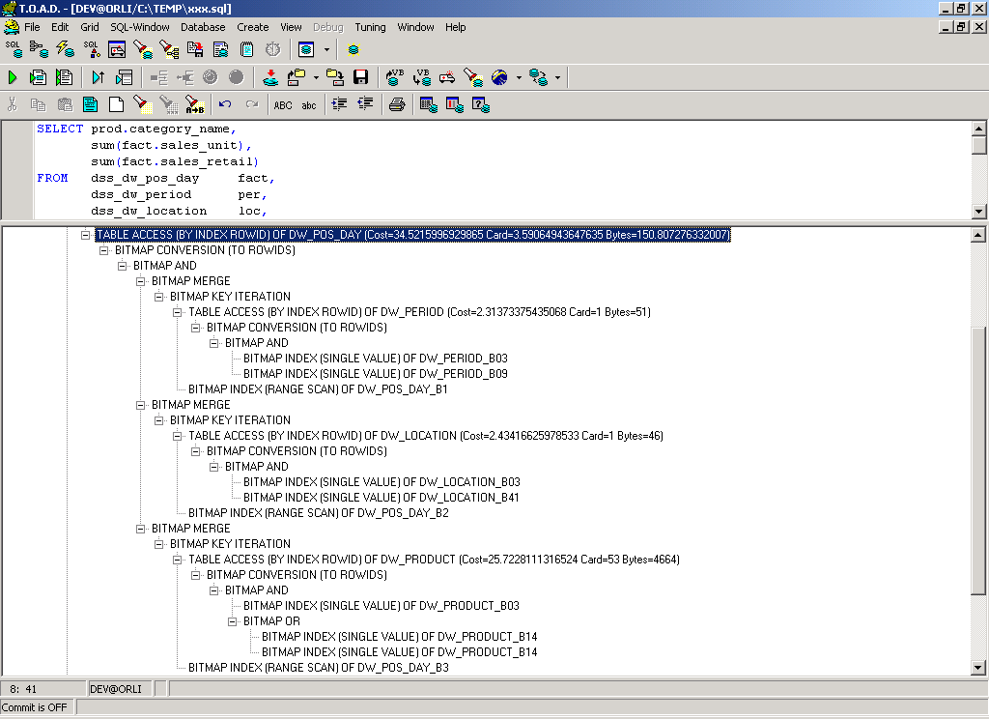
Star Transformation Explain
Star Transformation

Slide 37
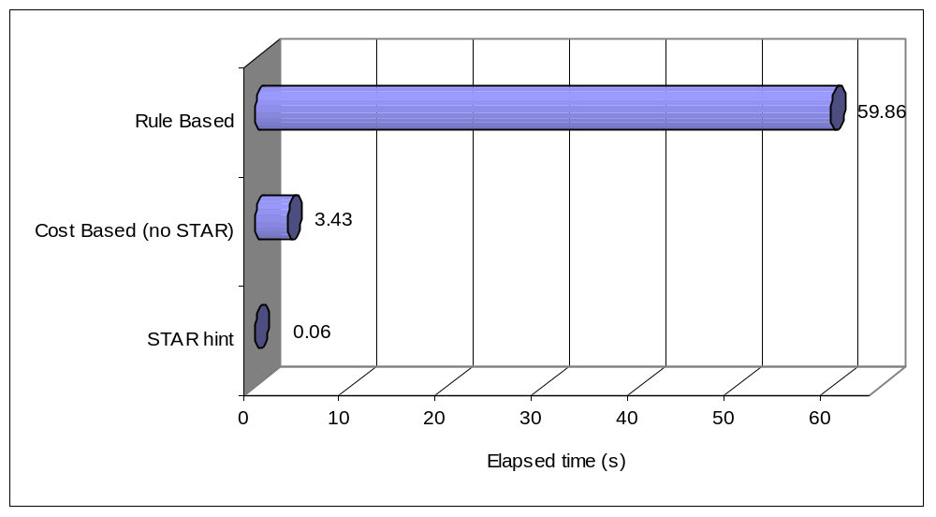
Star join performance
3 orders of magnitude difference between best and worst plan

Slide 38
Query Time vs. Serial/Parallel
Explain Plan | UNIX | NT
Serial, No Partition | 9,688 | 22,344
Serial, with Partition | 5,578 | 11,625
Parallel, No Partition | ORA-600 | ORA-600
Parallel, with Partition | 11,140 | 25,454
NOTE: specific to my data and user queries

Slide 39
Oracle Materialized Views
Way beyond the scope of dimensional modeling, but:
Special form of snapshots (i.e. replication)
End-users direct all queries against detail table
Optimizer rewrites queries to use best aggregate
Optimizer suggests new aggregates based on load
Eliminates need for numerous aggregation programs

Slide 40
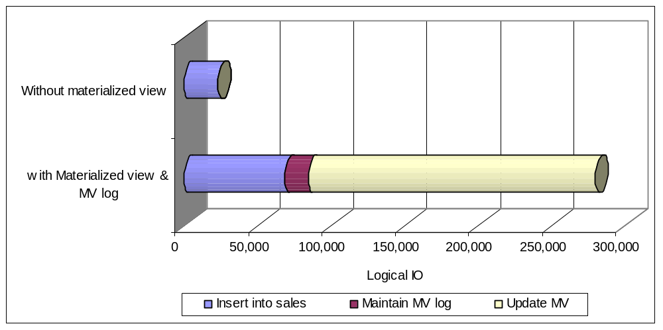
Exercise caution when creating materialized views
Conclusion: Better to rebuild MV after load – not concurrent with load

Slide 41
Parting Thoughts …
To be successful, all modelers’ mindset must change from an OLTP to DW/DM paradigm
There are many other key/core data modeling issues – this was just but one of them …
  Breaking models into sub-models
  Repository-based collaborative modeling
  Modeling the relationships between OLTP and DW models
  Documenting the meta-data for OLTP ETL transformations
  Modeling the Business Requirements
  Object-Relational Mapping
  etc, etc, etc …

